Slide 1
Emergency preparedness
Presented: Mario Ruiz, MD

Slide 2
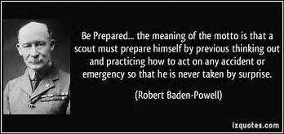
BE PREPARED
Notes:
Be prepared for life, have no regrets that you have tried your best to help other people

Slide 3
SCOUTS CAN MAKE A DIFFERENCE
OATH:
On my honor...to help other people at all times
LAW:
Trustworthy, Loyal, Helpful, Friendly, Courteous, Kind, Obedient, Cheerful, Thrifty, Brave, Clean and Reverent
FIRST AID
LIFE SAVING SKILLS
Notes:
You can make a difference by living by the Scout Oath and the Scout Law
Knowing First Aid and Life Saving Skills that could come in handy at any time.

Slide 4
WHAT IS AN EMERGENCY?
Something unforeseen, unexpected, requiring immediate action
Weather
Hurricane
Tornado
Snow storm
Flood
Extreme heat
Accidents
Explosion
Fire
Car accident
Hunting accident
Sports accident
Angry man/woman
Hazardous spills
Notes:
Fortunate in our times that we have lots of medical advances, better weather forecasting technology and cell phones
Can occur anywhere: mall, church, office, store, restaraunt

Slide 5
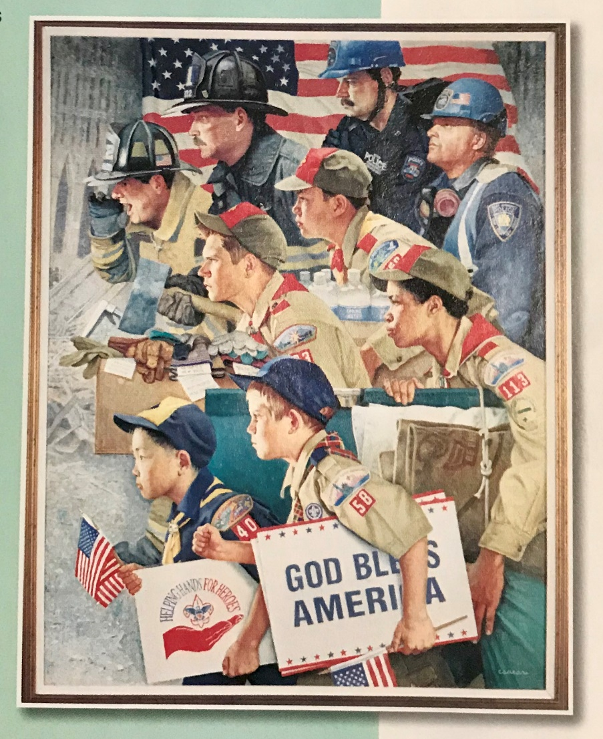
BE PREPARED
Have the knowledge to help others
Remain calm and level-headed
Take a deep breath
Assess the situation and plan on how to proceed
Focus on your task
Remember you may be part of a team
Don’t endanger yourself
The help can come to you
Look for exits
Notes:
Stay calm

Slide 6
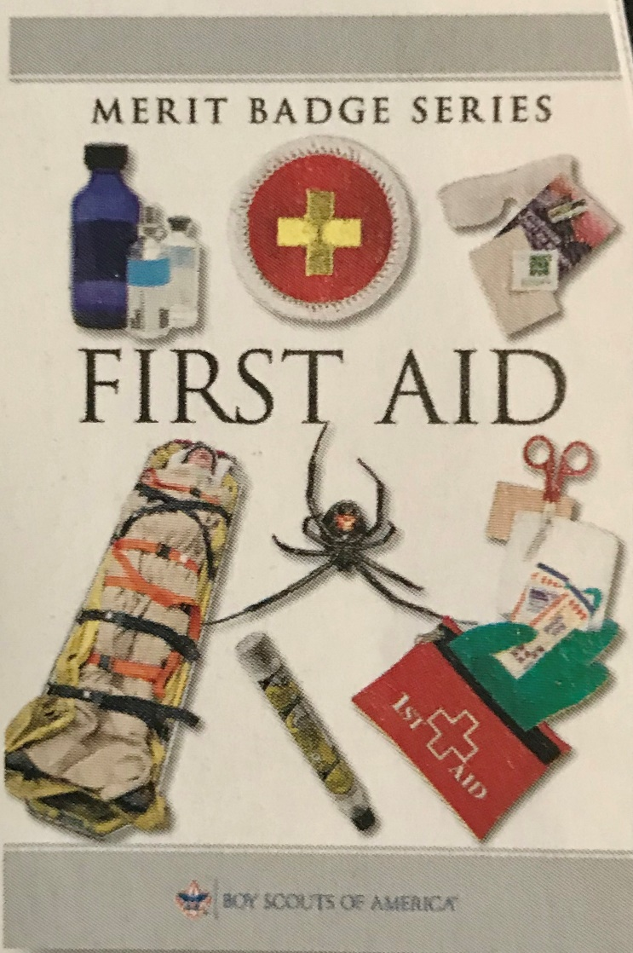
FIRST AID
Basic CPR
Choking
Blisters
Horsing around – cut, broken bone, not wearing helmet
Calling for help
Know your limits and when to call for help
Buddy system
Notes:
Those skills you learn here in scouts could prove useful in multiple every day situations.

Slide 7
Prepare, Respond, Recover, Prevent and Mitigate
Prepare
Recognize possible threats from natural or other disasters. Time of the year most likely to occur
Making a plan and practicing it (assemble emergency or supply kits)
Installing warning devices. Know how to contact local authorities
Family emergency plans, meeting places, quickest/safest routes, out of town contact
Respond
Help with shelter, first aid or other activities
Evacuate an area to reduce “secondary” damage
Recover
After disaster, trying to get things back to “normal”
Rebuilding, repairing property; do I have the necessary tools;.
Physical and emotional health support
Prevent
Prevent accidents from happening; how to make home safer from fire/explosions
How do I check for hazards
Mitigate
Help reduce the loss of life and property by lessening the impact of future disasters
Taking action before the next disaster. Make sure people are acting is a safe manner.
Notes:
These can some times overlap so as long as get the concepts I will be happy.
Ex. Driving a car – follows traffic laws and avoid distractions is less likely to have an accident (prevent). May not be able to prevent accident but if so, respond to help others in need. Mitigate damage by wearing seat belts.

Slide 8
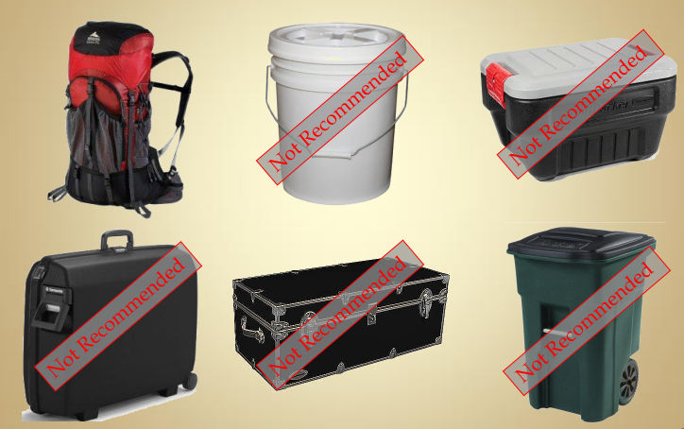
Some thoughts before you prepare a kit
Inspect your home to reduce the likelihood of disasters like fires, explosions, gas leaks, spread of disease, etc...
Home hazard hunt conducted from time to time; can help point out areas of risk
If evacuate, no idea how long you will be gone. A usual LAG TIME before supplies or help can get to you of at least 72 hours
Need supplies to keep you warm, dry, feed, hydrated and treat minor injuries.

Slide 9
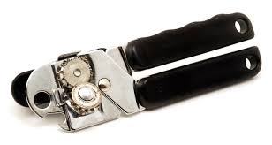
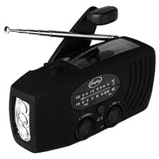
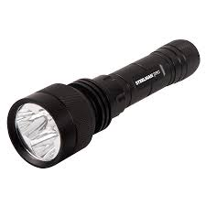
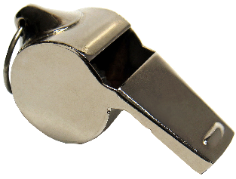
Family Emergency Kit
3 day supply of water (1gallon/person), stored in a sealed, unbreakable container
Nonperishable food (pet food?) and nonelectric can opener
Eating utensils
Special foods (elderly, baby), items (glasses, medications),battery chargers
First aid kit
Battery or crank powered radio
Flashlight, lantern, chemical light sticks
Extra batteries (stored separately, rotated regularly with fresh ones)
Matches in waterproof container, fire starting kit
Family documents : insurance cards, ID’s, emails, contact numbers in waterproof container
Blankets or sleeping bags
Extra clothes for the season
Dust masks for air filtering
Soap, wipes, or antibacterial soap
Toilet paper; emergency toilet (bucket, sawdust, litter, sand)
Whistle to signal help
Local maps
Cash and coins
Books, games, other personal comfort items
Sunscreen
Insect repellant
Notes:
Ready.gov basics of survival: fresh water, food, clean air and warmth

Slide 10
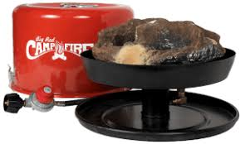
Master Disaster Preparedness Items
List of emergency telephone numbers, out of town contact person in case lines busy
Fire extinguisher
Tool kit (ax, shovel, broom, screwdriver, pliers, hammer, coil ½ inch rope, coil of baling wire, duct tape, razor blades, adjustable wrench for turning off gas/water
Simple chart showing where shutoff valves are located, including main electrical switch
Portable fire escape ladder for homes or buildings with more then 1 level
Portable stove with fuel (outdoor use to avoid carbon monoxide poisoning)
Gloves and rags
Covered containers (tightly seal) for storing refuse
Garden hose kept near an outside faucet at all times
Notes:
Phone with charger

Slide 11
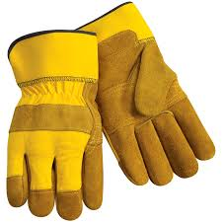
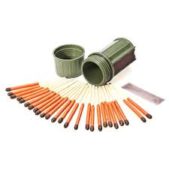
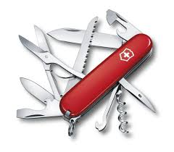
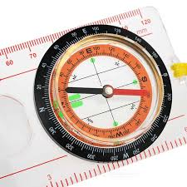
Personal Emergency Service Pack
Flashlight
Battery powered radio (extra batteries)
Hard hat, work gloves, dust maks
Weather related equipment (winter jacket, rubber boots, gloves, etc..)
Personal first aid kit (gauze, bandages, soap, antibiotic ointment, roller bandages)
Matches in waterproof container
Emergency rations (energy bar)
Bandana, facial tissues
Compass and map of area (or GPS)
Boots, long sleeved shirt, long pants, googles, safety glasses
Poncho or raincoat
Change of underwear and socks
Small bag: toothbrush, toothpaste, soap, comb, needle, thread, shoelaces, toilet paper
Sleeping bag (bedroll two wool blankets); waterproof ground cloth
Maps of areas
50 feet No 5 sash cord or similar size nylon cord
Pocket knife and ax/saw
Water treatment equipment
Cook kit and canteen
Pencil and small notebook
Watch
Notes:
Phone with charger

Slide 12
Home Kitchen Fire
Prepare
Train family, practice fire escape, shut off utilities
Respond
Use fire extinguisher, evacuate, call 911
Recover
Fire insurance, inventory of belongings
Prevent
Don’t leave cooking unattended
Smoke alarm
Fire extinguisher working condition
Mitigate
Keep flammables away

Slide 13
Home Basement/storage room/garage fire
Prepare
Train family, practice fire escape, shut off utilities
Respond
Use fire extinguisher, evacuate, call 911
Recover
Fire insurance, inventory of belongings
Prevent
Keep appliances inspected/working
Don’t store large amounts flammable
Mitigate
Keep flammables away from house
Clear closets, attics, cellar
Keep gas/fuel tanks away from heat sources

Slide 14
Explosion In Home
Prepare
Train family, practice fire escape, shut off utilities
Respond
Use fire extinguisher, evacuate, call 911
Recover
Fire insurance, inventory of belongings
Prevent
Don’t leave cooking unattended
Smoke alarm
Fire extinguisher working condition
Mitigate
Keep flammables away
Don’t overload circuits
Only small amounts of paint/flammables

Slide 15
Practice Before It Happens

Slide 16
Automobile Accident
Prepare
CPR/first aid certified, First Aid kit in car,
Respond
Call 911, check for injuries, stop bleeding, don’t move the seriously injured unless in danger
Recover
Help police, fire dept; health/auto insurance,
Prevent
Don’t text/talk on phone, don’t drink alcohol or do drugs, don’t distract the driver
Mitigate
Secure brakes, turn off engine,

Slide 17
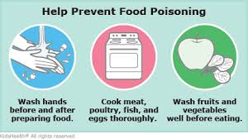
Food Borne Disease (food poisoning)
Prepare
Cook/handle food correctly, eat food within 2 hours of preparation
Respond
Call MD if sick, stay hydrated
Recover
Report food poisoning to local health professionals,
Prevent
Keep cold refrigerated, cook food to correct temperature
Mitigate
Keep yourself healthy, learn correct cooking and food handling techniques

Slide 18
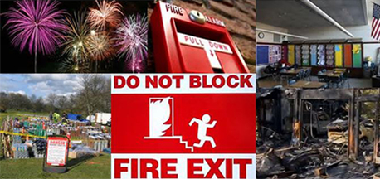
Fire Or Explosion In Public Space
Prepare
Know where fire exits are
Respond
Walk out of building, call 911 when safe, wave towel out window, keep door closed/open slowly
Recover
Children tend to hide (under beds/closets), help guide others
Prevent
Escape ladder, no elevators, school fire drills
Mitigate
Take key wherever you go, don’t go into building on fire, rescue team has correct info

Slide 19
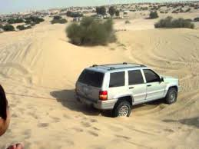
Vehicle Stalled In The Desert
Prepare
Prepare for hot/cold temp, make sure car running properly, have water/food, check weather report & travel plans, keep ½ tank gas, advise people of route
First aid kit, blanket, whistle, signal flares, booster cables, phone charged
Respond
Roadside assistance, stay with car, raise hood ->help
Recover
Drink water if dehydrated, see MD if feel ill, dew (clothes/sponge), water holes (birds/animals), avoid salty swamp water
Prevent
Keep to main roads, cell phone charged, leave trip plan with loved one
Mitigate
Inside car at night, stay with car in day, sit in shade, stay covered, leave note if leave car

Slide 20
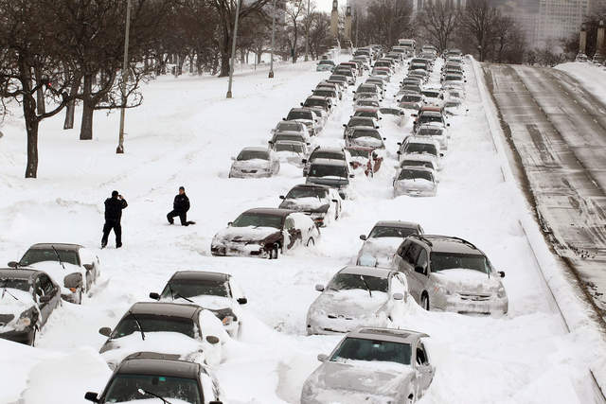
Vehicle Trapped In A Blizzard
Prepare
Prepare for the cold, car running properly, trip plans with loved one, flares, first aid kit
Respond
Roadside assistance, stay with car, raise hood ->help
Recover
Drink water if dehydrated, see MD if feel ill
Prevent
Food, water, warm clothes, tools, keep to main road, cell phone charged
Mitigate
Run engine 10 min/hour for heat, don’t let exhaust pipe get clogged, dome light night?, stay dry, hubcap fire/lighter, tinder-road map/paper

Slide 21
Flash Flooding In Town Or The Country
Prepare
Don’t camp in gully/dry streambed-flash flood, safest route to high ground, store water, flood evacuation bag
Respond
Local radio/tv to get alerts, follow instructions, more valuable 2nd floor if time
Recover
Throw away food, clean anything
Prevent
Know if live in flood zone, purchase flood insurance
Mitigate
Wait til all dry before turning on electricity

Slide 22
Mountain/back country accident
Prepare
Determine hazards/know area, compass, map, GPS, first aid kit, knife
Respond
Call 911, send someone for help if unsafe to move another, carry victim
Recover
Analyze for mistakes to avoid next time
Prevent
Know 1st aid, know signals for help, leave travel plan with others, travel in 3’s
Mitigate
Cell phone, ham radio with you

Slide 23
Boating Accident
Prepare
Life jackets & wearing , proper look out, fire extinguisher, lights, paddle and anchor
Respond
Stay low if move in boat, don’t swim to land, huddle together in cold
Recover
Head home if see storm, “mayday” x3, boats call number, boats name, position and what is the trouble
Prevent
Boat working well, waterproof emergency beacon, know capacity of boat, avoid boat near swimmer areas
Mitigate
<5 mph when landing, sound horn/bell, fly flag up and down, blink lights, fly flag upside down, flares

Slide 24
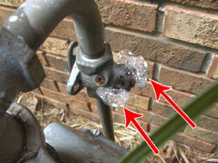
Gas Leak In A Home Or A Building
Prepare
Bad gas connector to furnaces, ovens, stoves and water heaters
Respond
Call 911, odor of gas, don’t look for source ->accidentally ignite
Recover
Get people out into fresh air, open windows, CPR
Prevent
Inspect appliances, CO monitors/alarms, check basement, garage and kitchen
Mitigate
Call gas company

Slide 25
Tornado Or Hurricane
Prepare
Preplanned location basemen/storm cellar, windowless, interior room; interior hallway school, lowest floor, restroom
Respond
Stay away from windows, first aid/help
Recover
First aid, store water/food, don’t leave windows uncovered
Prevent
Tie down/bring indoor loose furniture/cans, shut off electric/gas
Mitigate
Pets, meeting place after, text messaging may be preserved before calling

Slide 26
Major Flood
Prepare
Route to high ground, RedCross, evacuation road given, store water containers, highest place in house
Respond
Move to 2nd floor/roof, warm clothes, radio, flashlights
Recover
Don’t drive flooded roads, car stalled abandon it
Prevent
Sandbags not pile up to foundation ok if water to cellar to equalize pressure, turn off gas, unplug electrical appliances., water to
Mitigate
Water recede throw out food, even canned food as may contaminated, test water well first, be sure anything electrical is dry before use it

Slide 27
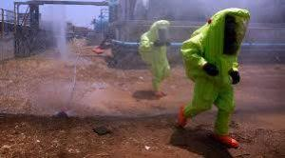
Toxic Chemical Spills And Releases
Prepare
State/county response programs, community warning system, shelter in case evacuation, close flue fireplace if indoors
Respond
Change clothes, listen for authorities
Recover
First aid burning eyes, mouth, throat or lungs get to hospital
Prevent
F
Mitigate
Turn off a/c ventilation

Slide 28
Nuclear Power Plant Emergency
Prepare
State 10 mile and 50 mile radius, warning system alarm recognition
Respond
Change clothes, if told to stay indoors close doors/windows and chimney;
Recover
Notification of unusual event, alert, site area emergency or general emergency
Prevent
Learn where to go
Mitigate
Turn off a/c vent, keep food covered in fridge

Slide 29
Avalanche (snowslide or rockslide)
Prepare
Avoid dangerous high country without guide, don’t throw rocks/push rocks, don’t walk behind or below
Respond
Buddy system, shovel, transceiver, probe snow, move straight down and not across
Recover
Let snow settle 3 days, check advisories, stay off slope taking sun, watch and tell rescuers where to look
Prevent
Early am sunmelts snow/ice, heavy rains weaken silt, rocks at base =talus, no short cuts and stay on trails
Mitigate
Stay within ski areas, avoid back country, avoid bottom narrow valleys, ravines and gulches esp if below steep slopes

Slide 30
Violence In A Public Place
Prepare
Emeergency exits, report unsafe condition, carry cell phone
Respond
Don’t panic, keep others calm, call 911 when you can
Recover
Help friends/family & victims cope with trauma or loss
Prevent
F
Mitigate
Don’t contact violent offenders

Slide 31
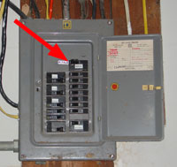
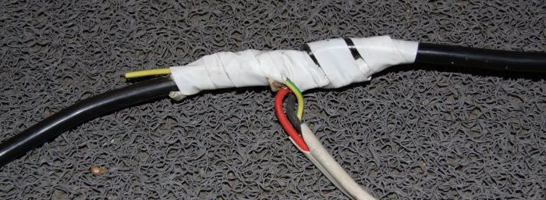
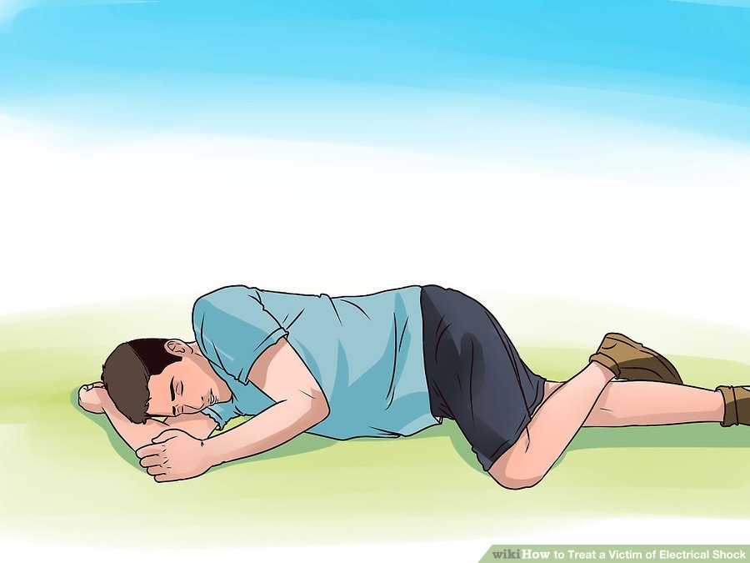
How You Could Safely Save A Person Live Wire:
Touching a live household electric wire
Muscle tighten
Don’t touch the person
Pull out cord from insulated portion
Shut off power at circuit breaker
Push person with wooden stick, rolled newspaper, towel or other implement that doesn’t conduct electricity
Call 911
CPR, Recovery position

Slide 32
First Aid :Electrocution

Slide 33
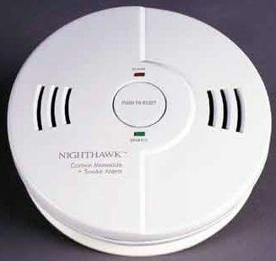
How To Safely Save A Person: Carbon Monoxide
Odorless/colorless
CO come from grills, appliacnes, fire places, gas powered tools, running car in garage
Make sure fuel burning appliances & fireplaces inspected by professional at least once a year.
Never burn charcoal in home or garage
Symptoms: headaches, dizziness, faintness, ringing in ear, nausea
Stops breathing, rescue breathing
Call 911

Slide 34
Potential Carbon Monoxide Sources In The Home

Slide 35
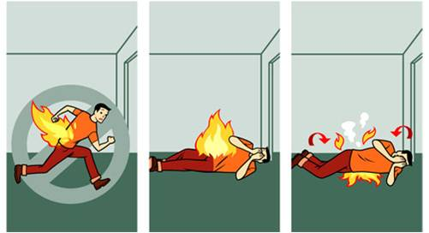
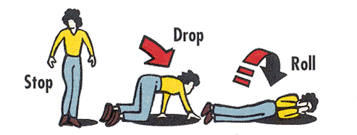
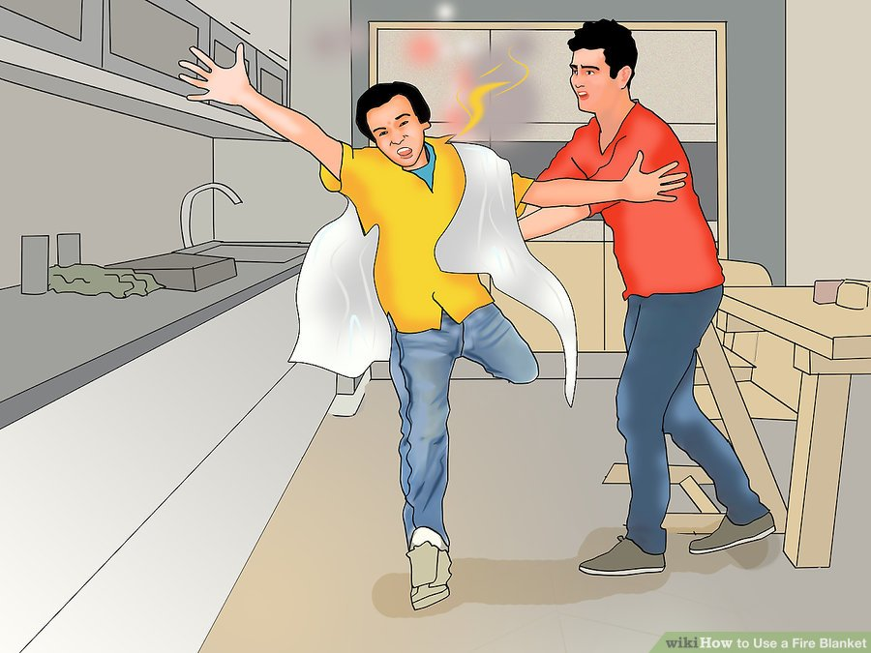
How You Could Safely Save A Person: Clothes on Fire
Cover with blanket/fire proof
First Aid
Call 911
Cold Water
Stop, drop & roll
Cover face with hands
NO running: flames burn more

Slide 36
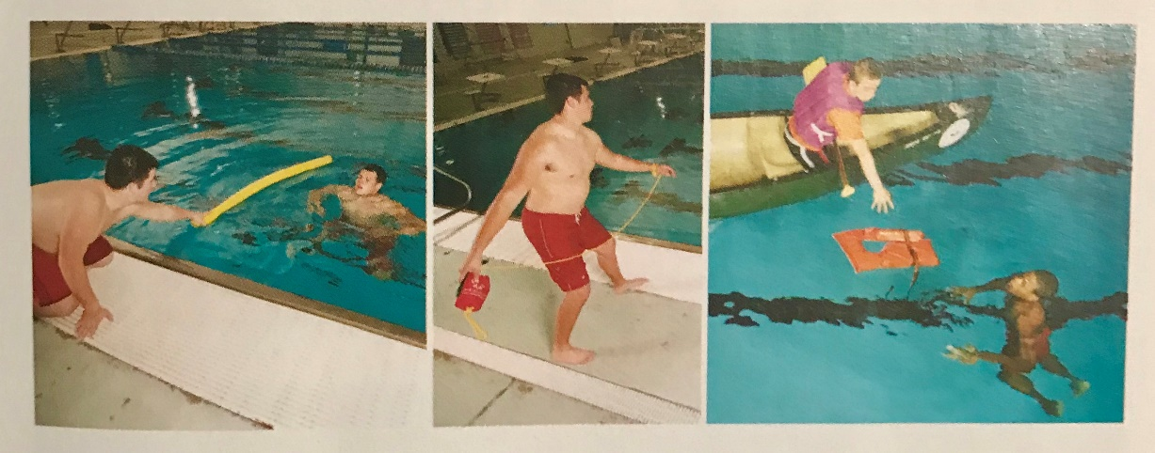
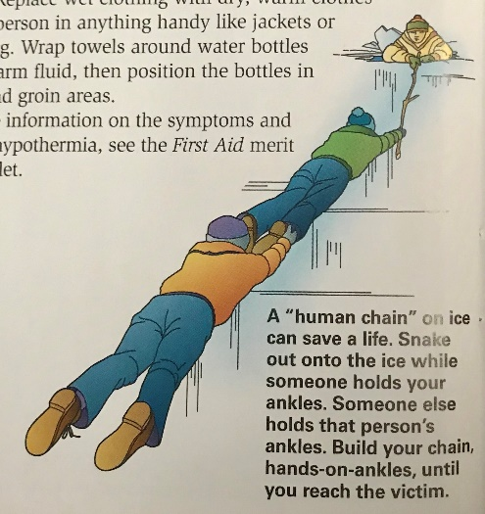
How You Could Safely Save A Person: Drowning Using Non-Swimming Rescues (accidents on ice)
Don’t endanger yourself by going into water unless you are trained/life guard
Reach: stick, object, pole
Throw: ring floater on rope, life jacket/rope, inner tube, air mattress, kick board, cooler
Row: canoe, boat, ?surfboard, paddle board, air mattress
-non contact-grab object
Go with live support – colleagues, friends, buddy
Ice rescue can form human chain, reach with pole, tree branch, oar. Throw rope, slide buoy to them. Carefully go spread eagle over ice
-hypothermia, replace wet clothing, warm bottle armpits

Slide 37
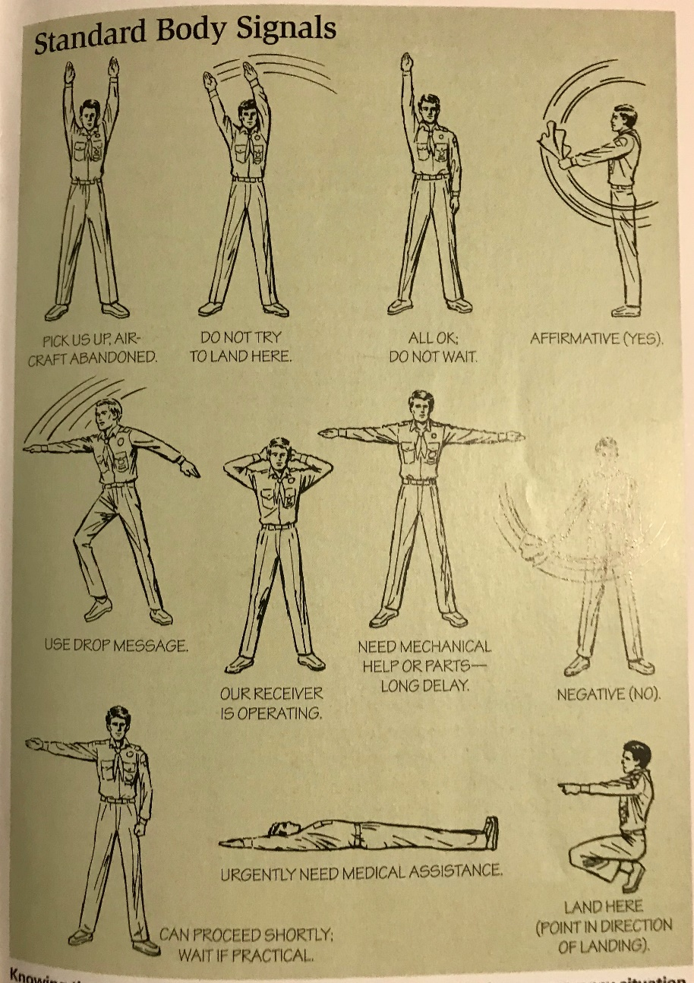
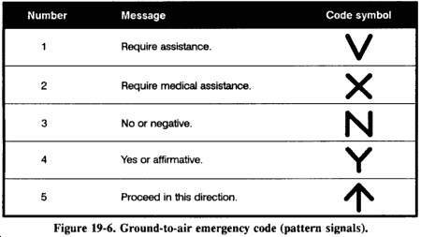
Attact/Communicate With Rescue Planes/Aircraft

Slide 38
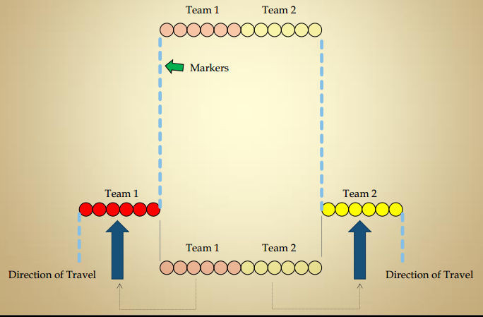
Search and Rescue
In mountainous or wildness areas usually already volunteer search-and-rescue teams. Helicopters, horseback, trained dogs.
SEARCH TACTICS:
Preliminary: where was person last seen? Any wildness experience,? how dressed ? What equipment did they have?
Confinement: barricade & string lines, keep lost from wandering from known area, searchers assigned to block roads/trails
Detection: “lost person search method”
Tracking: dogs, skilled searchers looking at foot prints.
Evacuation: found may need treatment for injuries.

Slide 39
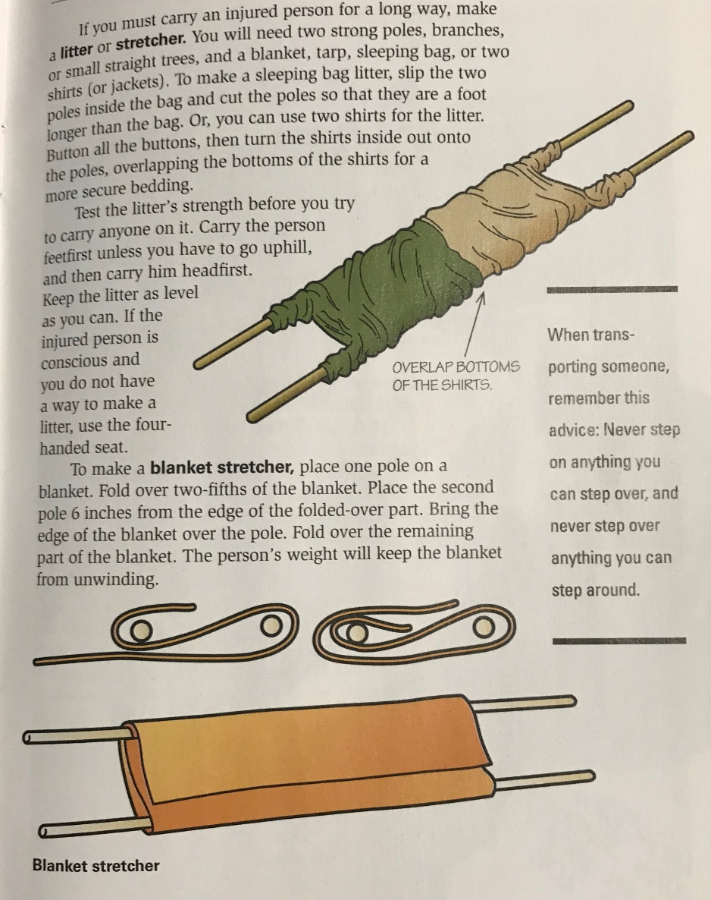
Move An Injured Person Out Of Remote/Rugged Area
Buddy carry in interlocking arms if conscious
Drag on stretcher
Stop every 30-60 minutes for 10 minutes

Slide 40
National Incident Management System (NIMS)/Incident Command System (ICS)
Provide citizens with routine that can be used by whole community to manage emergency situations
Prevent loss of life
Reduce property damage
Avert harm to the environment
Incident Command Center – Public Information Office
HOW DO SCOUTS HELP:
Call, volunteer, clean up, provide supplies, passing out of info

Slide 41
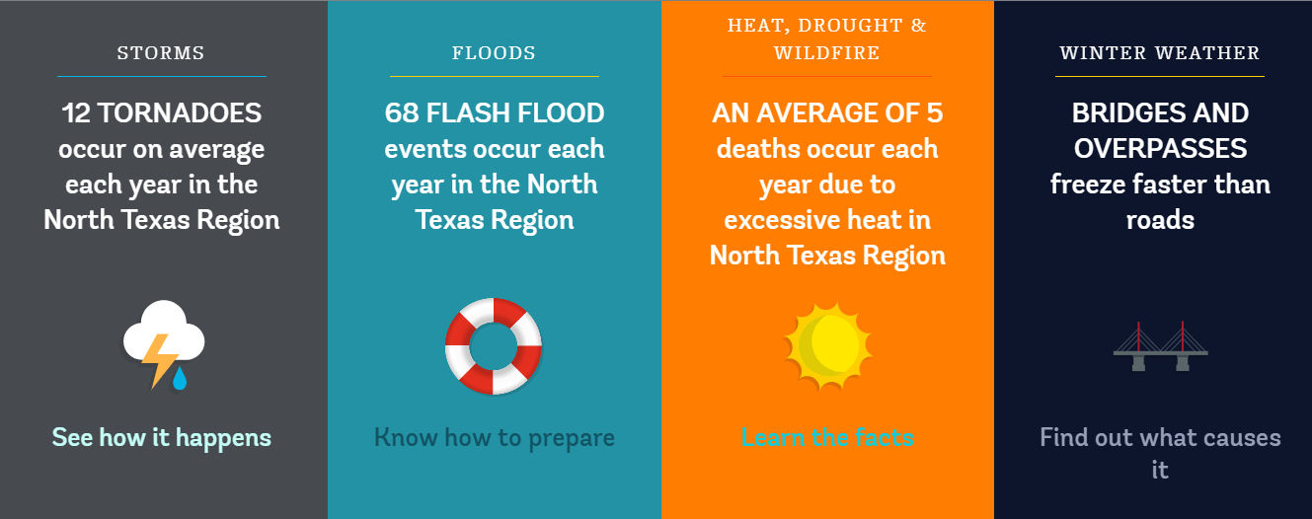
CERT (community emergency response team)
CERT programs educate people about disaster preparedness for hazards that may impact area and train in basic skills –light search/rescue, team organization & disaster medical operation. Use training to then help others; critical support to first responders.
City of Irving
-Jason Carriere Emergency Mangement Coordinator
-Think/Prepare/Act
KnowWhat2Do.com
-tornado, airport ,major business

Slide 42
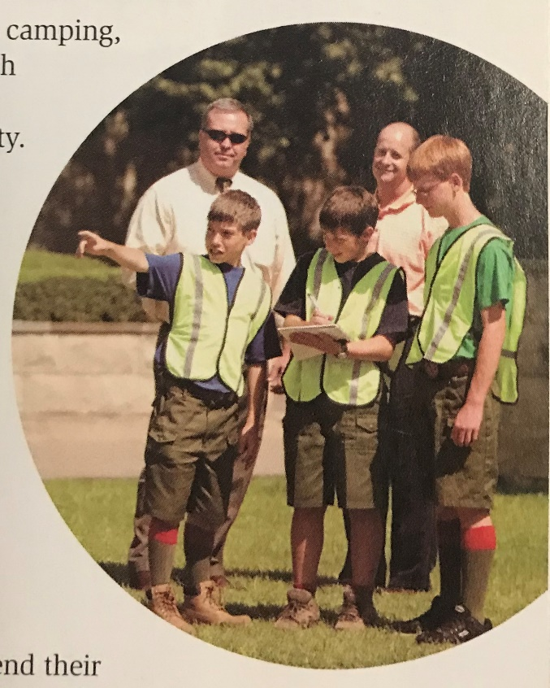
Crowd and Traffic Control
Prepared to do :
Caution tape
Flashlights
Reflective vests
Supervision of office in charge
Training needed:
Crowd behavior
Traffic safety
Safety Precautions:
Supervision is necessary
Leave if situation gets dangerous

Slide 43
Messenger Service And Communication
Prepared to do:
Map area and assign sections
Know your area
Ham radio, tactical communication, signalling
Carry personal ID, list of critical numbers, cell phone, flashlight, first aid kit, pencil/paper,map, bike tool kit, money
Training needed:
Bike safety
Brief messages
Radio/telephone etiquette
Safety Precautions
Bike safety
Traffic safety

Slide 44
Collection And Distribution Services
Prepared to do:
Maps
Distribution & collection locations usually set up at church, fire station, school or public building
Training needed:
Food collection (scouting for food)
Safety precautions:
Crowd control

Slide 45
Group Feeding, Shelter and Sanitation
Prepared to do:
Cooking equipment
Latrine equipment
Tents
Boil water, cooking can, fire started, trench shovels, twine/rope to mark serving areas
Training needed:
Cooking knowledge
How to set up tents
Safety precautions:
Crowd control

Slide 46
Sample Home Safety Checklists
Stairways, halls and outdoor steps
stairways with3 or more steps have a strong handrail and slip resistant finish
Stairways & halls are kept free from boxes, toys, shoes, brooms, tools and other tripping hazards
Gates at top & bottom of stairs prevent children from falling
The head & foot of stairs have no small or loose rugs
Stair carpeting or covering is fastened securely
Stairways & halls have good lighting, controllable at each end
Kitchen
Matches are kept where children cannot get them
Emergency numbers are posted next to the telephone, including 911 and poison control
Knives & sharp instruments are kept in knife drawers or holder
Can openers don’t leave sharp edges on cans
Disinfectants & cleaning products are out of reach of children
Pan handles are turned away from stove edges
Spilled grease, water or bits of foods are wiped up immediatiely
Pot holders are located near the stove, within easy reach
A dry chemical fire extinguisher is mounted near the stove

Slide 47
Sample Home Safety Checklists
Attic and Basement
Ladder is strong, solid and sturdily constructed
Stairway is sturdy and well lighted
Children keeps skates and play gear in a specific place
Walls and beams are free from protruding nails
Fuses or circuit breakers are the proper size
Rubbish & flammable materials are in covered metal cans
Wastepaper is kept away from furnace and stairs
Living Room and Dining Room
Furniture is placed to allow easy passage in an emergency
Before bedtime, furniture placement is checked for orderliness
Furniture and woodwork solid, in good repair, and free from splinters and rough spots
Fireplace screen fits snugly
Rugs are fastened or laid on non slip pads
Rugs are kept from curling at their edges
Wax on floors is thoroughly buffed
Fire in fireplace is extinguished at bedtime
Candles are in stable holders and fully extinguished after use, before bedtime or before leaving home

Slide 48
Sample Home Safety Checklists
Bathroom
Tub and shower are equipped with strong handholds
Tub floor has non-slip surface
Poisons and dangerous chemicals are marked, sealed shut in original containers, and out of reach of children
Medicines are out of reach of children in childproof containers.
No one takes medicine in the dark
Bedroom
Smoke alarm has fresh battery or secure electrical connection & is tested regularly
Carbon monoxide detector has fresh battery or secure electrical connection and is tested regularly
Furniture placement for clear passage between bed and door
Light switch or lamp is within easy reach from bed
A night-light illuminates bedroom or hall
Bureau and dresser drawers are closed when not in use
Bar across upper bunk beds help prevent falls
Children are taught not to lean against windows or screens
Low sill windows have sturdy screens to prevent children from falling out
Smoking in bed is prohibited
Gas and electric heating devices are turned off at bedtime.

Slide 49
Sample Home Safety Checklists
Nursery
Bars on cribs are closely spaced – no more then 2 3/8” apart so baby’s head cannot slip between them
Crib is approved by Consumer Products or similar
Crib is free from sharp edges or corners
Cribs does not have a “drop” side
Sleeping garments and coverskeep baby warm without danger of smothering
Pillows are kept out of bassinet or crib
No thin, plastic material is in or near the crib
No toys or objects in or near the crib or within reach of any child under 3 or less than 1 inch in diameter and 2 inches long
No toys or objects have small parts that can be removed
Children are taught not to give marbles, etc to younger children
Toys are sturdy, do not come apart easily, & have no sharp edges or points
Nontoxic paint is used on baby furniture and toys
All houseplants are nonpoisonous

Slide 50
Sample Home Safety Checklists
Stoves, Furnances and Heaters
Stoves are away from curtains
Stoves & furnance pipes and flues are inspected and cleaned annually
Gas burners are properly adjusted and free from leaks
Gas water & space heaters are equipped with vents or flues
Water heater or boiler has a safety valve & is checked yearly
Water heater temperature is set below 120 deg Fahrenheit to reduce the risk of serious burns
Flames of gas burners are protected from drafts
Insulating shield protects woodwork within 18” of furnace, etc.
Keep flammable materials away from stoves, furnaces, etc.
A wrench is stored near the shut-off valve of outside gas line
The flue is opened before using the fireplace

Slide 51
Sample Home Safety Checklists
Porch, Yard and Garage
Railings and banisters are sound and inspected periodically
Steps and walks are kept free from ice and snow
Yard/play space are free from holes, stones, glass, etc.
Tools and dangerous articles are out of reach of children
Dangerous products & chemicals are kept in original containers in locked storage areas
Wires and low fences are brightly painted or clearly marked
Wells, cisterns and pits are kept securely covered
Disposable materials are not burned outside
An area is marked off in the garage for bicycles, wagons, etc.
Lawn mower is equipped with proper safeguards.

Slide 52
Sample Home Safety Checklists
Workshop
Good ventilation exists, especially when sanding or painting
Safety goggles or face mask and hearing protection are worn when working with or around power tools and an appropriate eye wash is available
Baking soda is kept handy to neutralize acid burns
All electrical tools are eihter grounded with three-wire plugs or are double insulated.
Work area is well lit & free of clutter, scraps and rags.
All tools have a place & are in their place
Guards are in place on all power tools
A push stick is available for use with power saws
Tools are unplugged when not in use and before changing blades, servicing or repairing

Slide 53
Sample Home Safety Checklists
Electrical Devices and Fixtures
Electrical fixtures and appliances are located & used beyond arm’s length of the sink, stove, tub, shower, or other grounded metal unless outlet is protected by a ground-fault interrupter
Do not touch electrical fixtures or appliances with wet hands
Disconnect seldom used appliances when not in use
Household appliances are disconnected before repairs
Light bulbs are installed in all lamp sockets
All pull-type sockets have an insulating link
Frayed or worn electric cords are promptly replaced
Long trailing cores are not in evidence
Cords are kept out from under rugs,doors and furniture
UA-approved extension cords are the proper size
Children are taught never to touch electric sockets or fixtures
Fuses are adequate for the load and are not bypassed
Circuit breakers are labeled and not overloaded

Slide 54
Sample Home Safety Checklists
For Emergency
Know how to get emergency help (911, poison control, etc.)
Be able to find water, gas & electric shutoffs. Check annually.
First aid kit approved by your doctor/American Red Cross
Know basic first aid procedures
Have a fire escape plan from your home
Emergency water supply
Handheld flashlights readily available
In earthquake-prone areas, make sure that the water heater and bookcases are bolted to the walls

Slide 55
Sample Home Safety Checklists
General
Home has smoke & carbon monoxide detectors with at least one smoke detector in each bedroom, near the kitchen and in the basement & garage
Everything has a place and is in its place
Stepladders are in good repair and stored out of the way
Window screens and storm windows are securely fastened
Guns are stored unloaded and in locked cases
Guns & ammunition are stored separately
Children are permitted to use only blunt end scissors
Housework clothing has no drooping sleevs, slashes, or frills
Shoes worn for housework have low heels
All shoes are in good repair
Kerosene, gasoline, paint thinnersand other volatile materials are stored outside in special clearly marked metal containers
Oil mops, dust rags, painting equipment and other oily materials are stored outside in open metal containers.
Everyone turns on a light before entering a dark room
Matches are extinguished before they’re thrown away
Children are never permitted to play with matches
Fire extinguishers are readily available and in good working order

